Slide 1
Input image
Feature Maps
Convolutional Kernel
Pooling Layer
Convolutional Layer
Fully Connected Layer

Slide 2
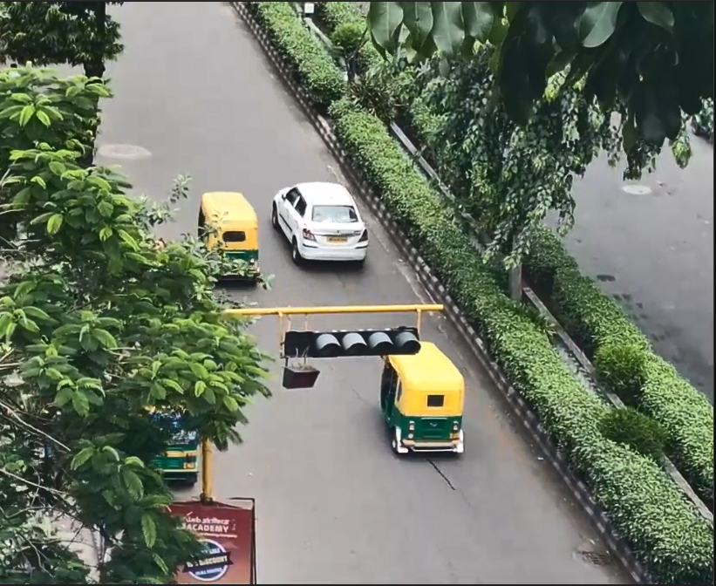
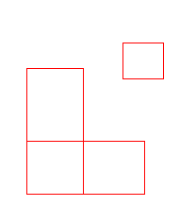

RCNN
Feature Map
SS Proposal
Crop Region
Resize
C SVMS
CNN
Regressor
(contains bounding boxes)

Slide 3
Fully Connected Layers
Crop Region
ROI Layer
C+1 Softmax
(extra for background)
SS Proposal
Regressor
(contains bounding boxes)
CNN

Slide 4
ROI Layer
C+1 Softmax
CNN
Regressor
Feature Map
Fully Connected Layers
Regressor
2 Softmax
Region Proposal Network

Slide 5
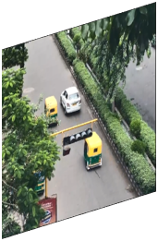
Feature Vector
Feature Map
Divide into n*n grids
CLS Softmax
CNN
Resize
Regressor
(contains bounding boxes)

Slide 6
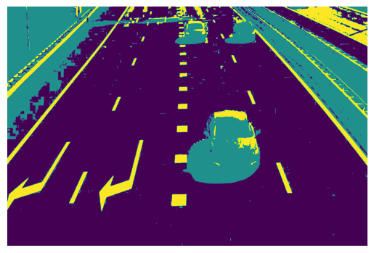

Slide 7
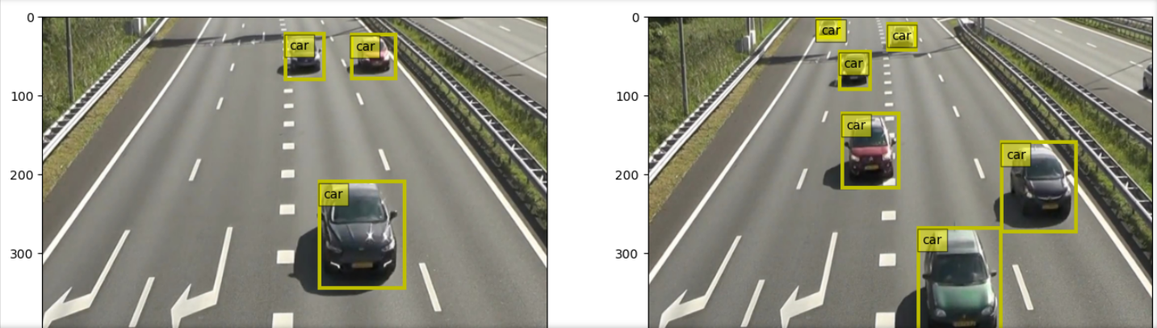

Slide 8
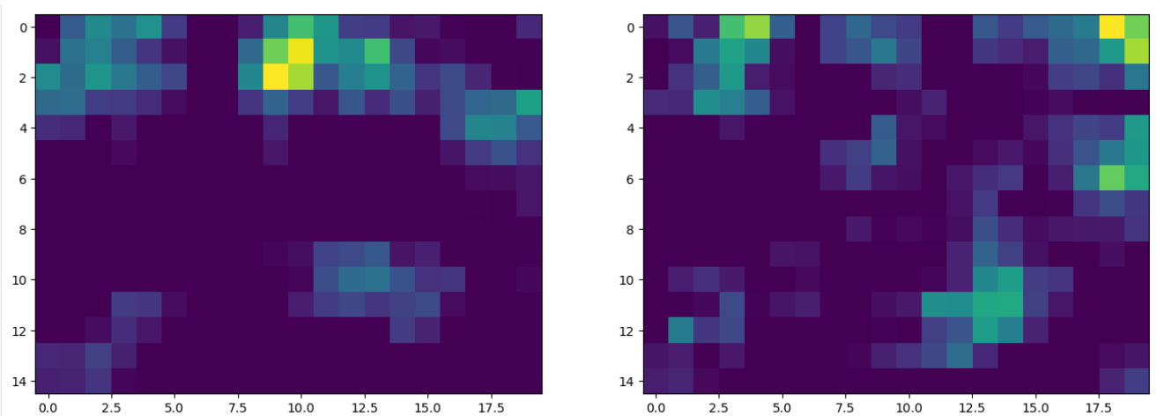

Slide 9
